Slide 1

System Design for Recommendations and Search
Akash Mathur

Slide 2
Agenda
It is an algorithm that suggests relevant items to users.
What
Why
How
Personalization
Better Retention
Enhanced Engagement
Enhanced Customer Loyalty
Improved Sales and Revenue

Slide 3
Questions
What is the difference between Content-Based Filtering and Collaborative Filtering ?
What is a Cold Start problem?
Aspect | Content-Based Filtering | Collaborative Filtering
Basic Concept | Recommends items similar to those the user liked, based on item attributes and user profiles. | Recommends items based on the preferences of similar users.
Data Requirements | Requires information about item attributes and user profiles. | Requires historical user-item interaction data.
User Cold Start | Handles user cold start problem well, as it can make recommendations based on user preferences and item characteristics even with limited user data. | Struggles with user cold start problem since it needs data on user-item interactions to make accurate recommendations.
Item Cold Start | Struggles with item cold start problem, as it requires sufficient data about item attributes to make relevant recommendations. | Handles item cold start problem well, as long as there is data on other users interacting with the item.
Diversity of Recommendations | May have limited diversity in recommendations, as it heavily relies on item attributes and user preferences. | Generally offers more diverse recommendations as it considers preferences from multiple users.
Serendipity | May lack serendipity as it recommends items similar to the ones the user has already liked. | Can offer more serendipitous recommendations by suggesting items popular among similar users, which the user might not be aware of.
Hybrid Approaches | Easily combinable with other recommendation techniques, including collaborative filtering, to create hybrid systems. | Can be combined with content-based filtering or other techniques to form hybrid recommendation systems.

Slide 4
System Design for Recommendations and Search

Slide 5
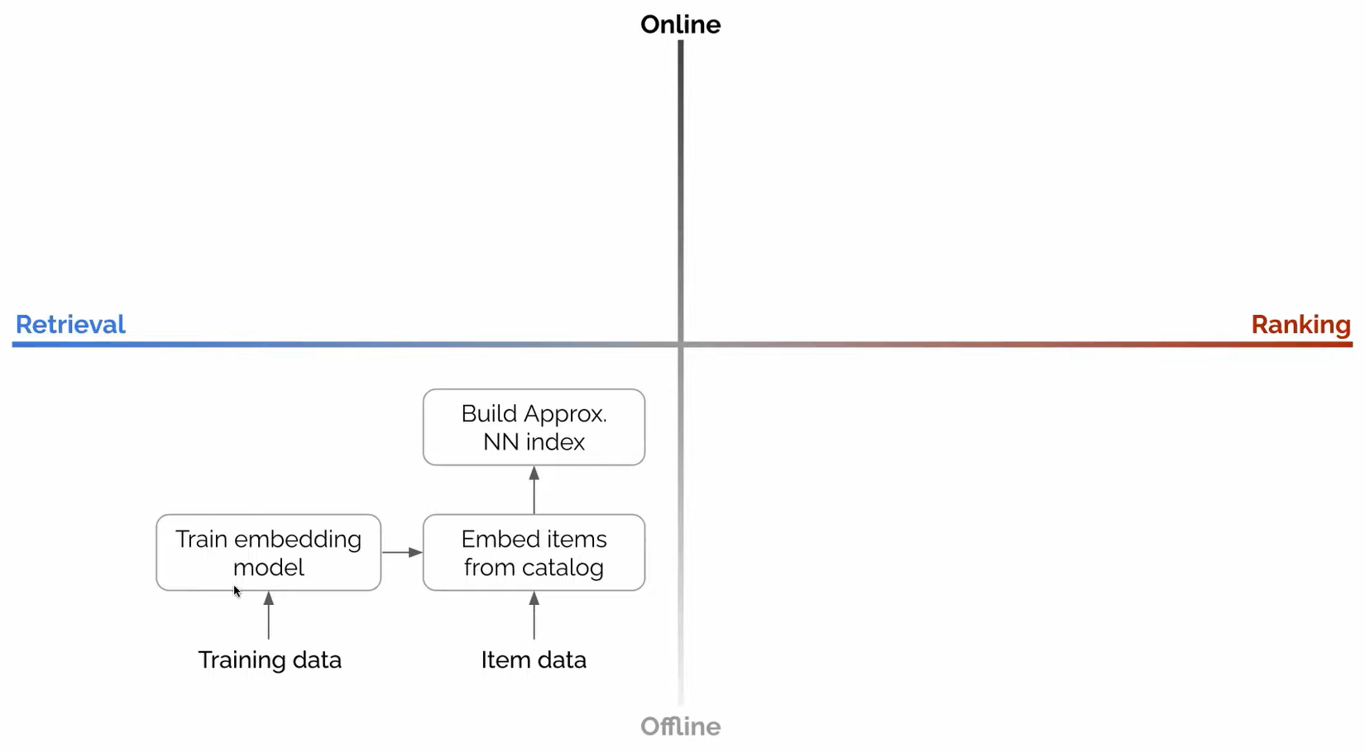

Slide 6
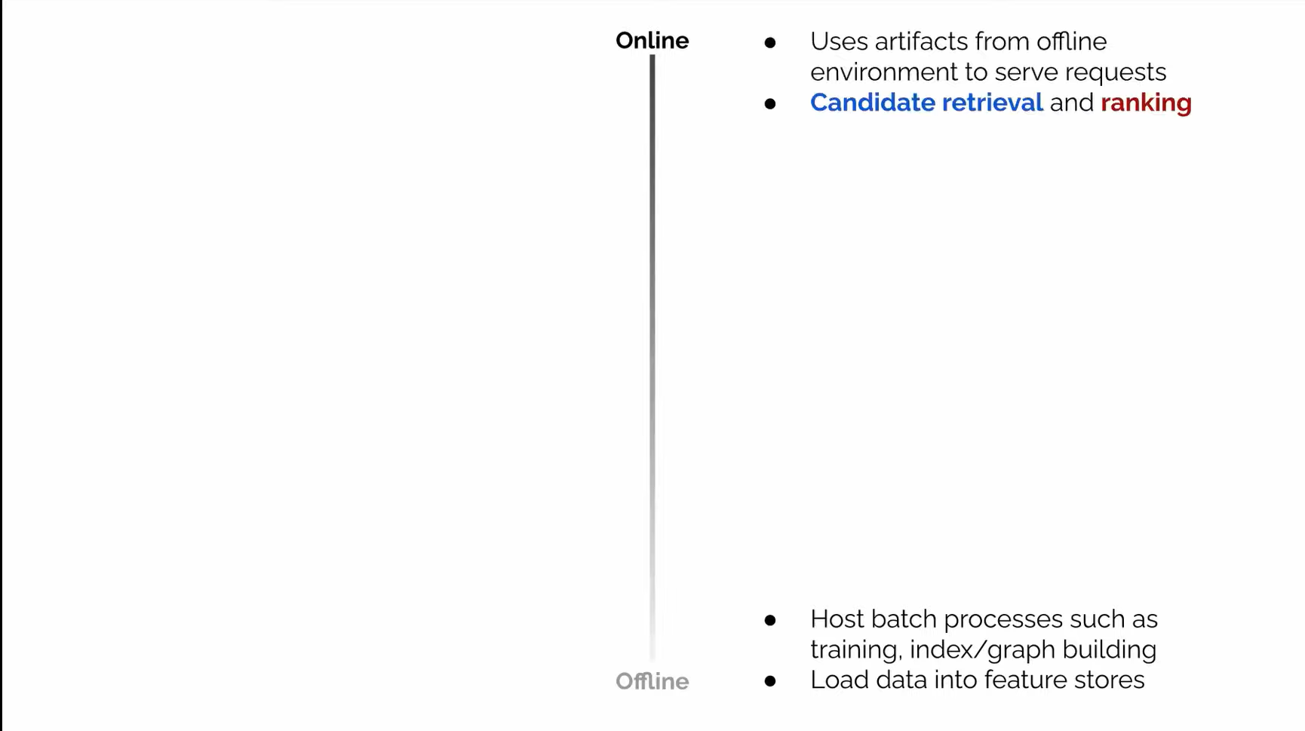

Slide 7
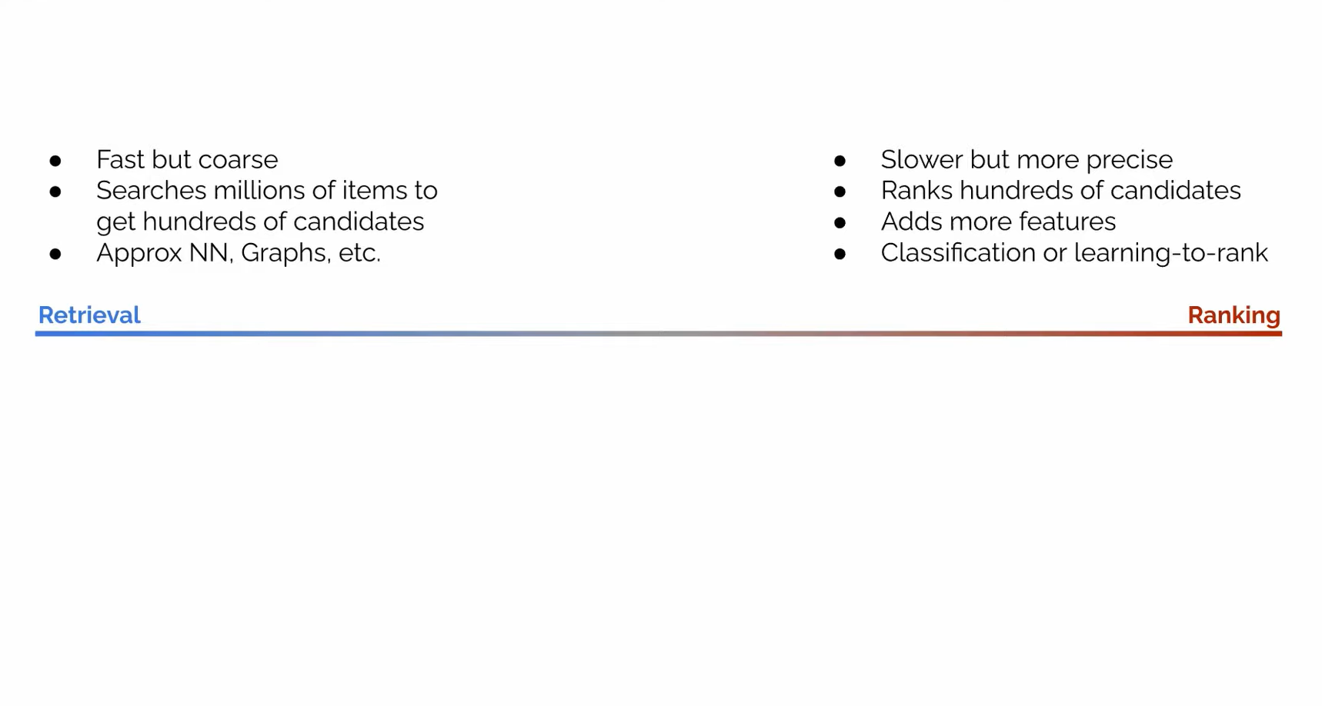

Slide 11
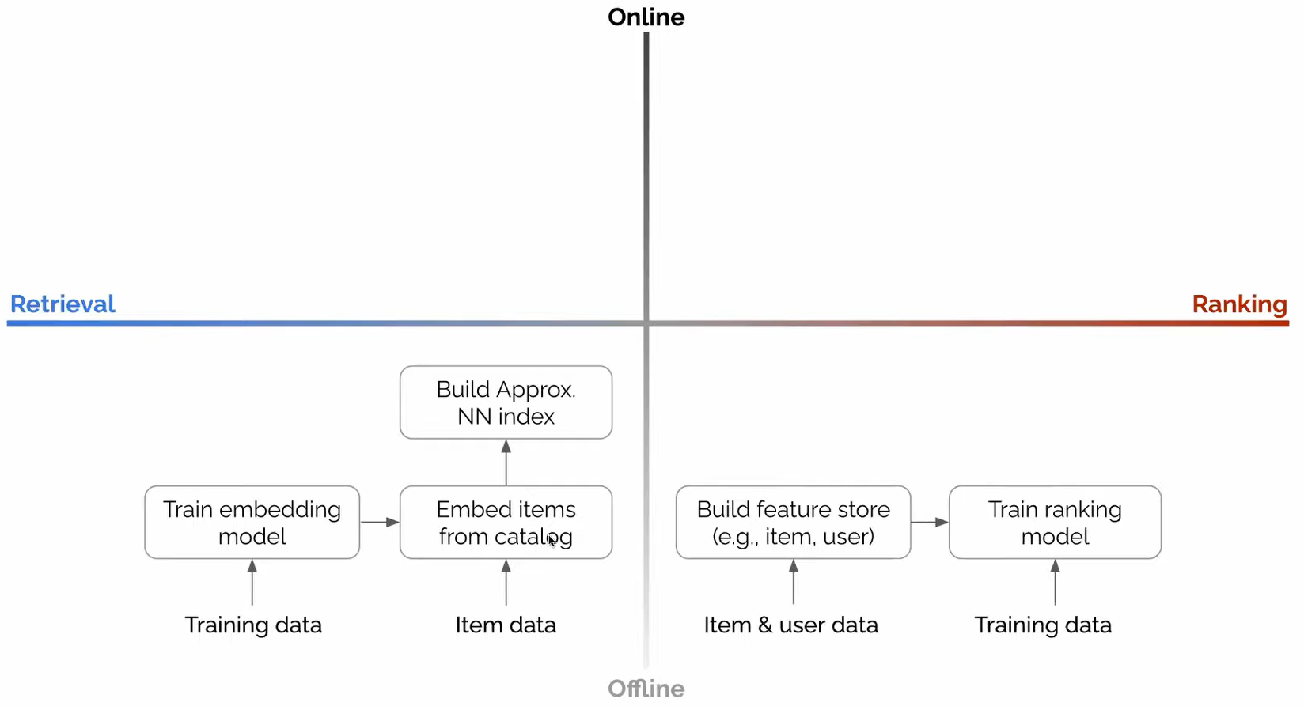

Slide 13
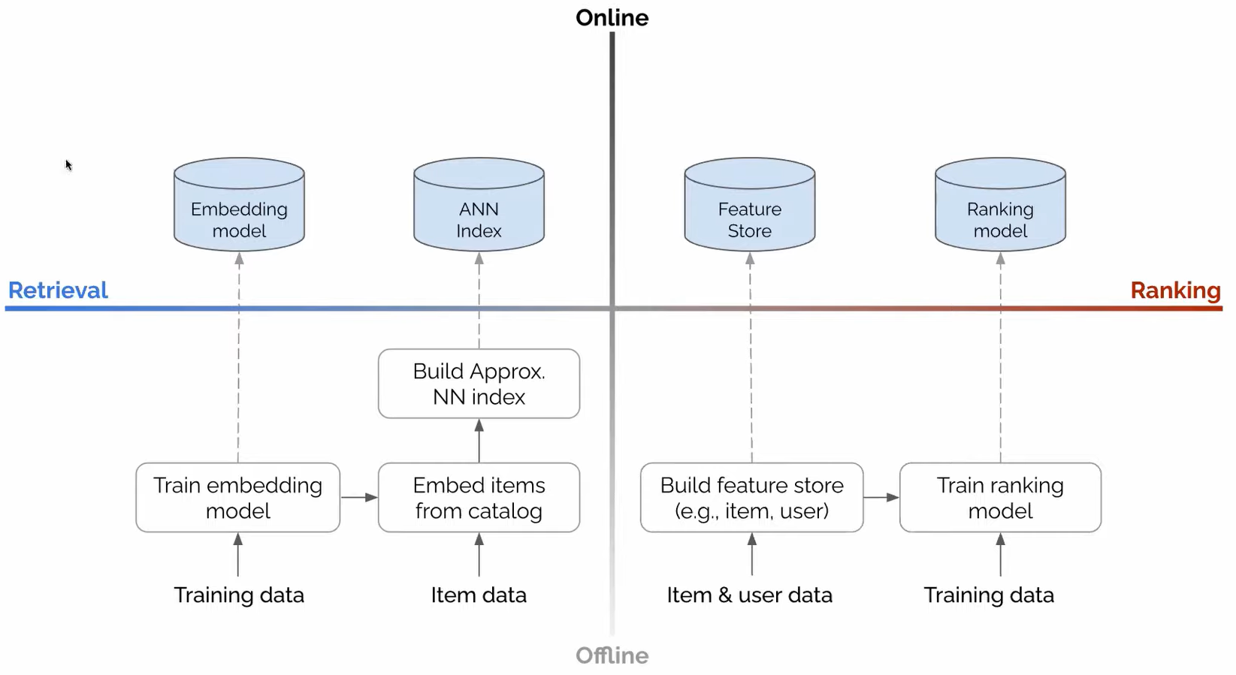

Slide 14
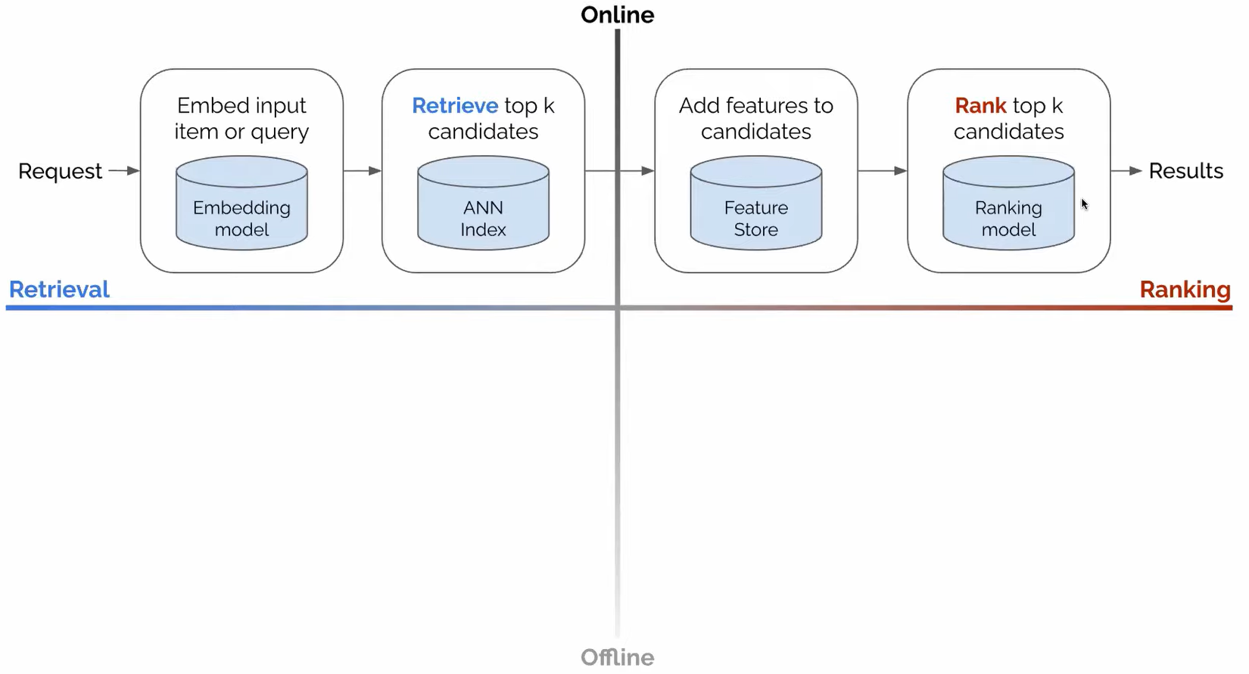

Slide 15
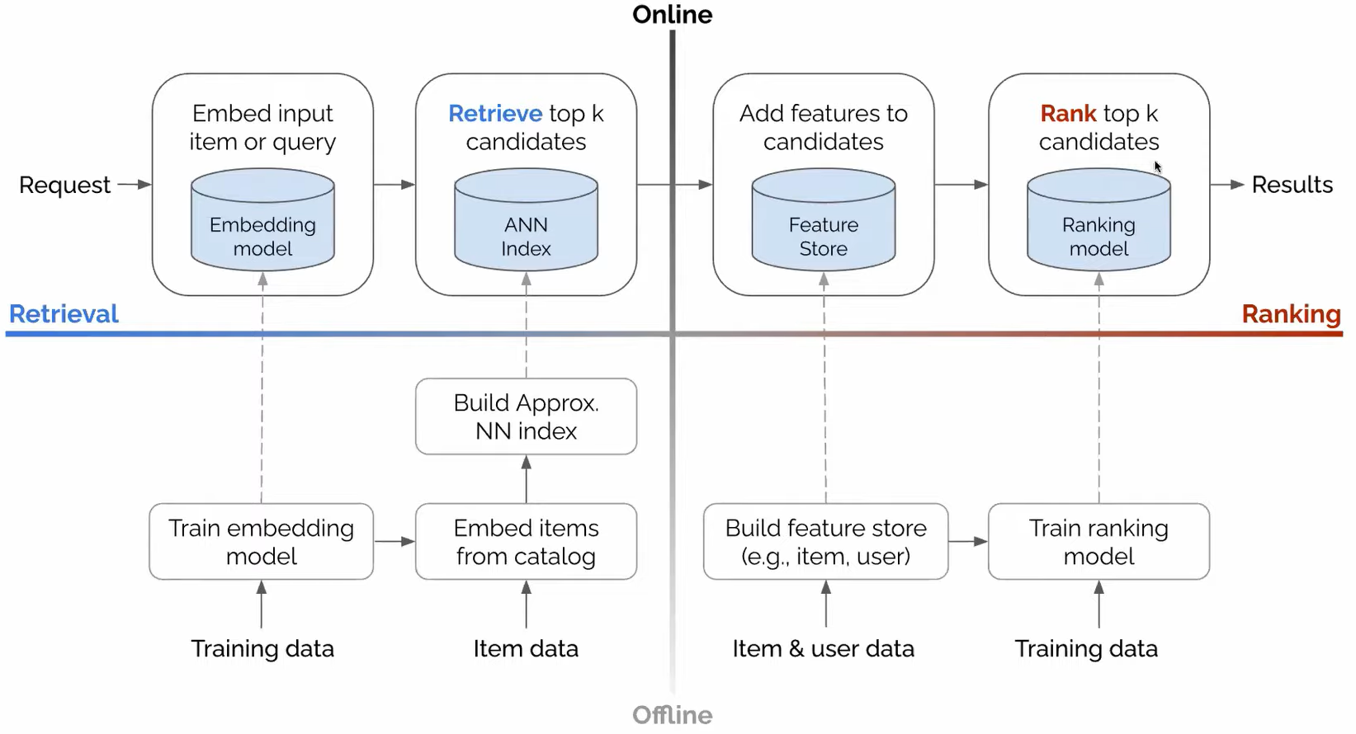

Slide 16
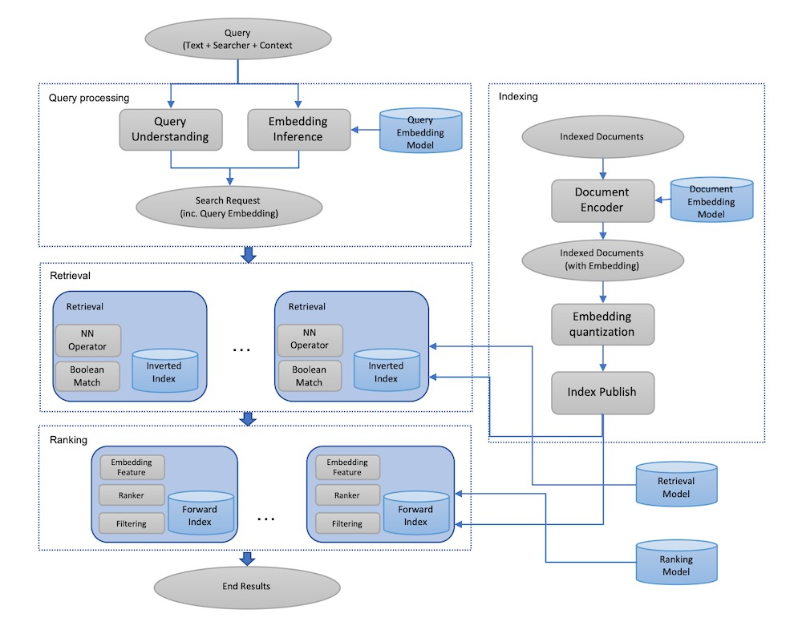
Facebook’s Embedding-based Retrieval for Search

Slide 17
Thank You

